Slide 1
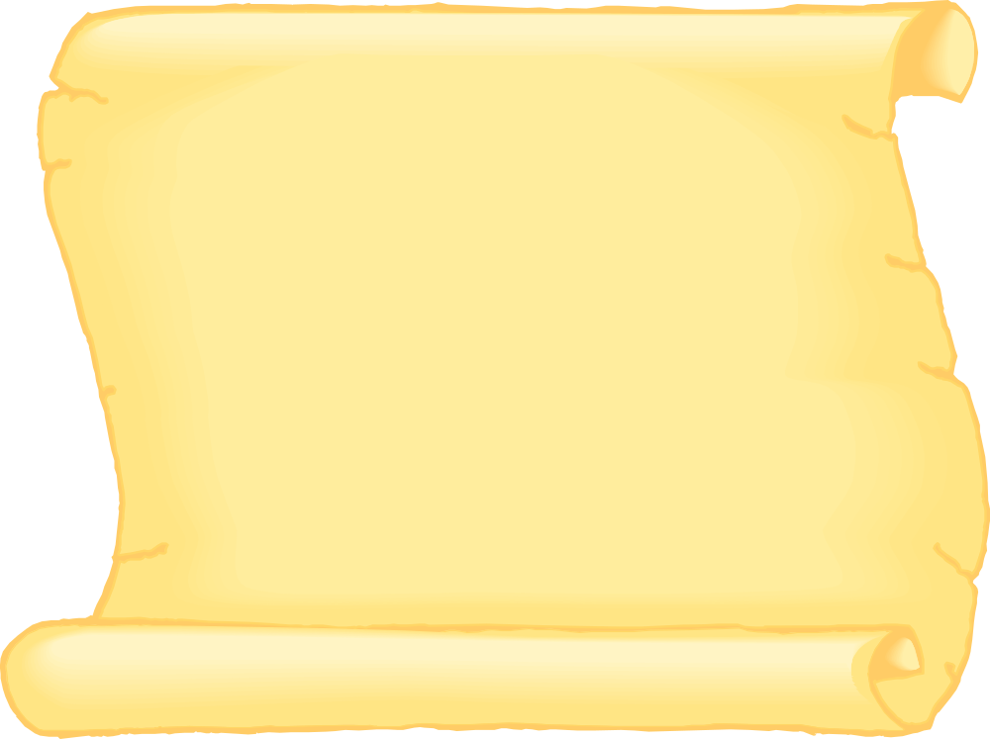
Jabberwocky
By Lewis Carroll
www.instantdisplay.co.uk

Slide 2
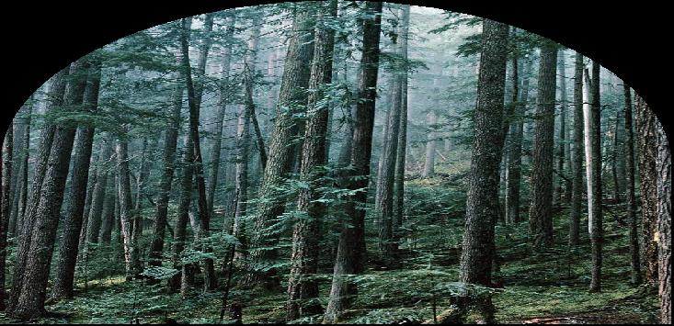
'Twas brillig, and the slithy toves
Did gyre and gimble in the wabe:
All mimsy were the borogoves,
And the mome raths outgrabe.
www.instantdisplay.co.uk

Slide 3
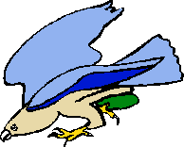
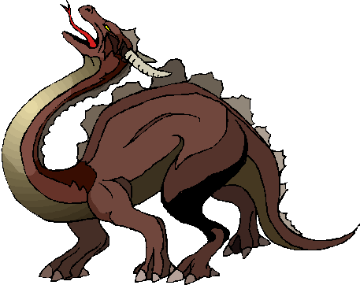
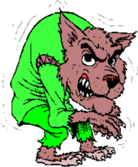
"Beware the Jabberwock, my son!
The jaws that bite, the claws that catch!
Beware the Jubjub bird, and shun
The frumious Bandersnatch!"
www.instantdisplay.co.uk

Slide 4
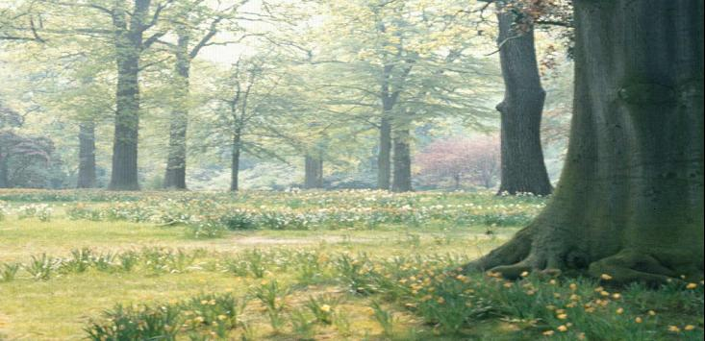
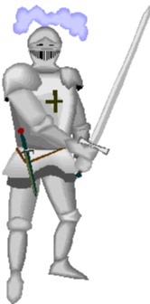
He took his vorpal sword in hand:
Long time the manxome foe he sought -
So rested he by the Tumtum tree,
And stood awhile in thought.
www.instantdisplay.co.uk

Slide 5
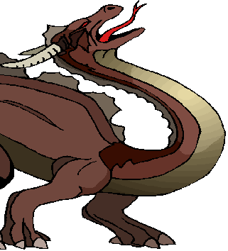
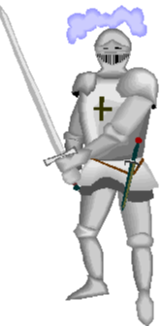
And, as in uffish thought he stood,
The Jabberwock, with eyes of flame,
Came whiffling through the tulgey wood,
And burbled as it came!
www.instantdisplay.co.uk

Slide 6
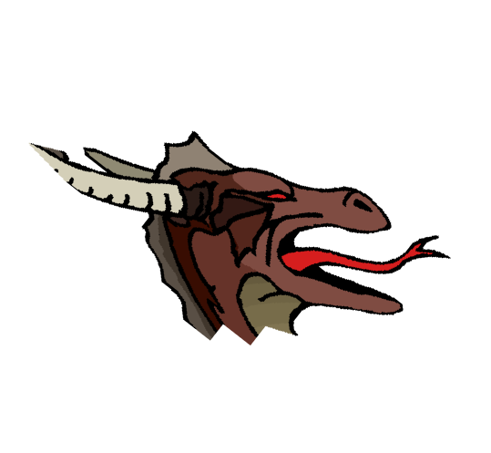
One, two! One, two! And through and through
The vorpal blade went snicker-snack!
He left it dead, and with its head
He went galumphing back.
www.instantdisplay.co.uk

Slide 7
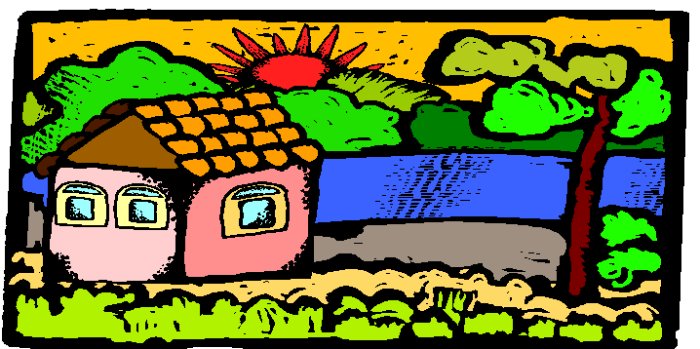
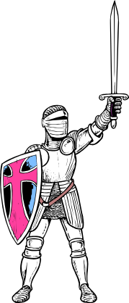
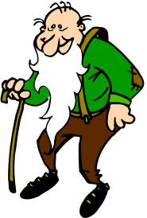
"And hast thou slain the Jabberwock?
Come to my arms, my beamish boy!
O frabjous day! Callooh! Callay!"
He chortled in his joy.
www.instantdisplay.co.uk

Slide 8
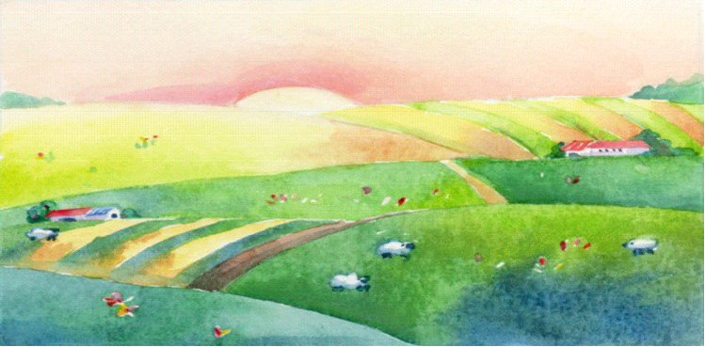
'Twas brillig, and the slithy toves
Did gyre and gimble in the wabe:
All mimsy were the borogoves,
And the mome raths outgrabe.
www.instantdisplay.co.uk

